Slide 1
Programming
Requirements
Code

Slide 2
Programming
Requirements
Logic

Slide 3
Requirements
Mind the Gap!
Logic

Slide 4
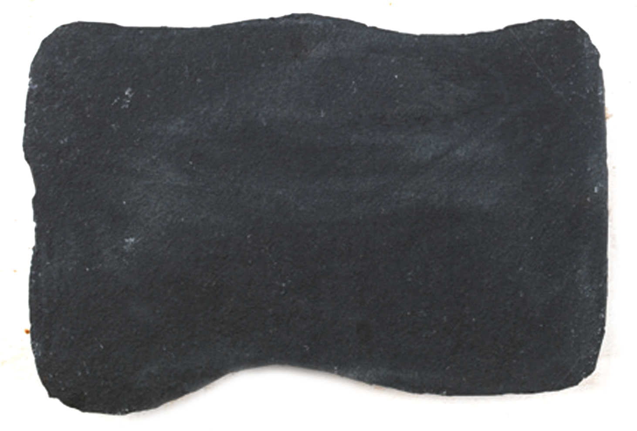
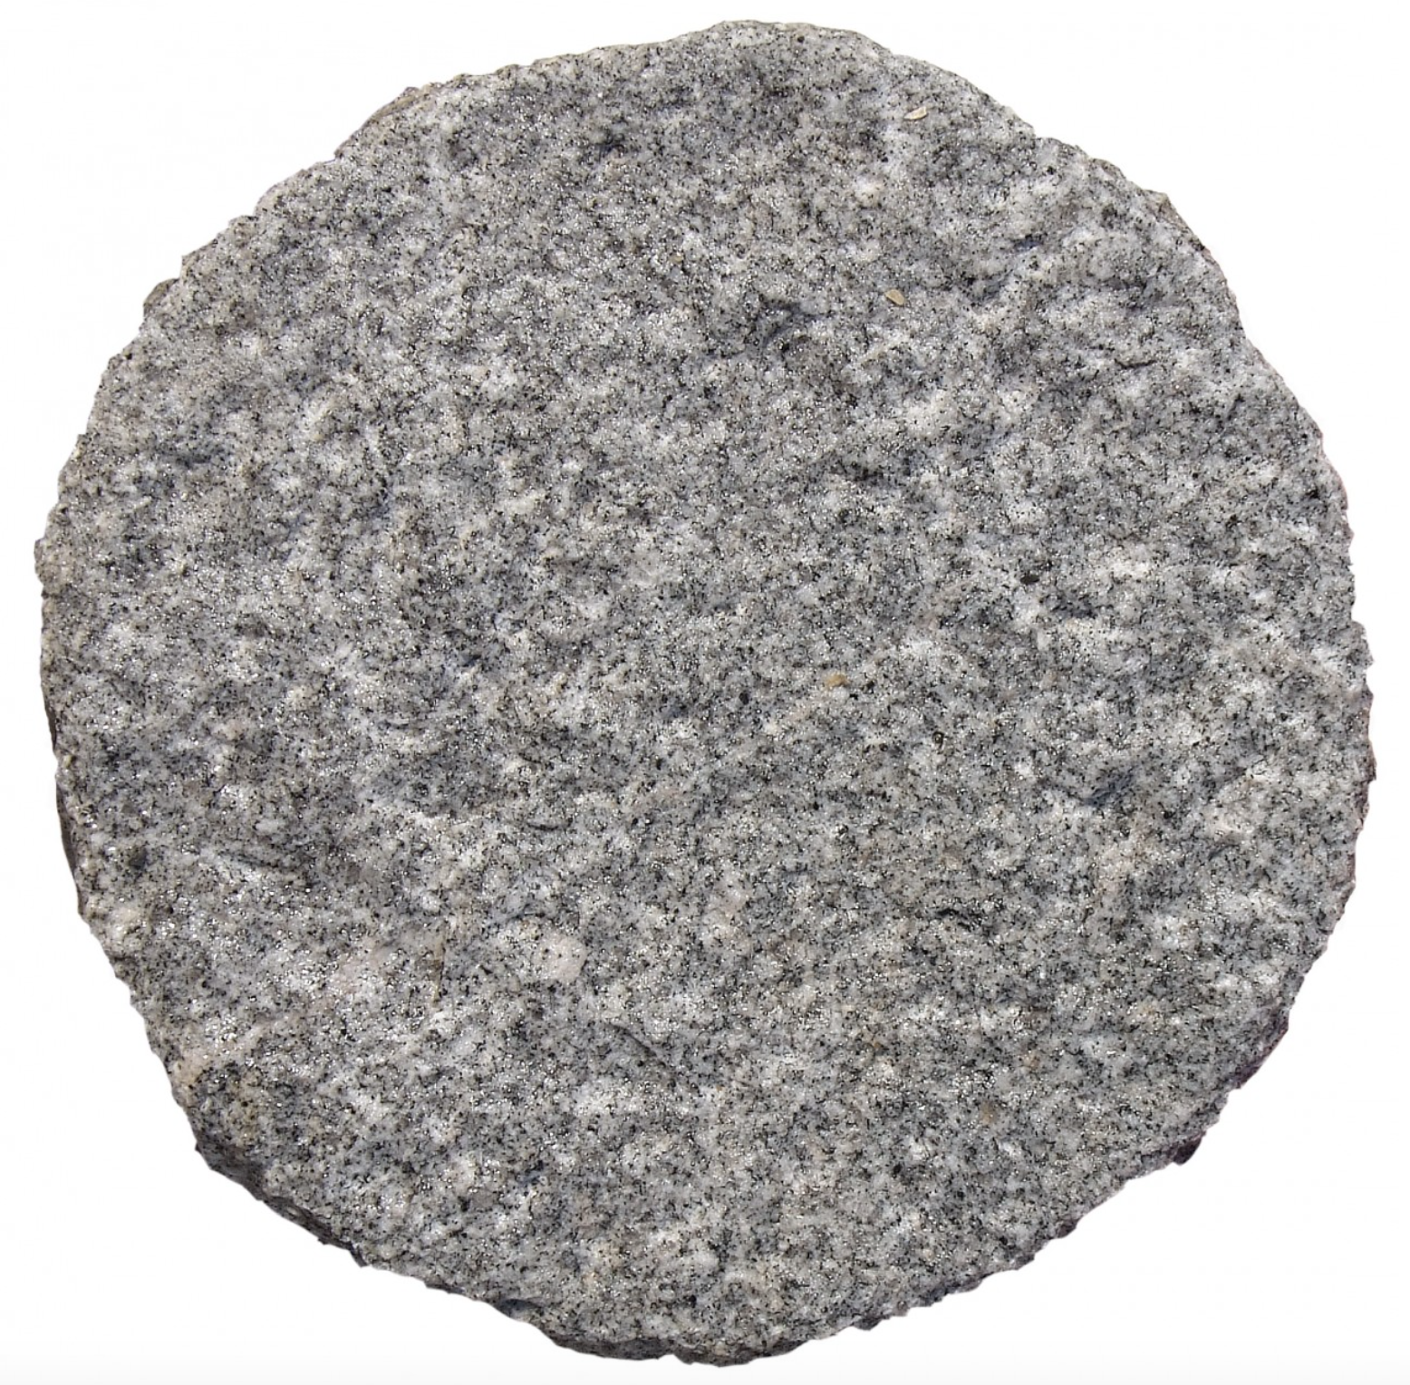

Requirements
Problem analysis
Solution
design
Implementation
Logic

Slide 5
Problem analysis
Solution design
Implemen-tation
?
?

Slide 6
Problem analysis
Solution design
Implemen-tation
?
Functions

Slide 7
Problem analysis
Solution design
Implemen-tation
Functions
Functions

Slide 8
Requirements
Problem analysis
Coarse grained function scope
Solution design
Implementation
Fine grained function scope
Logic

Slide 9
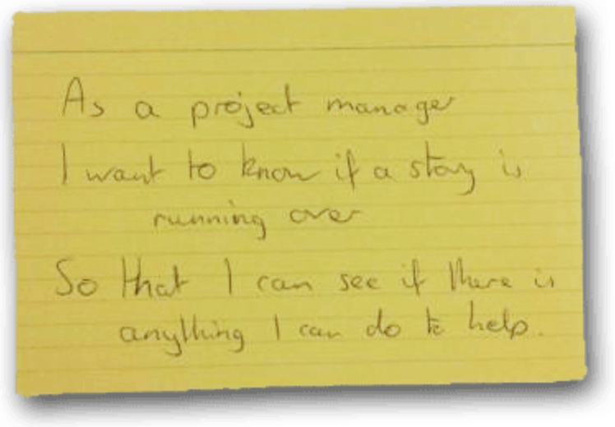
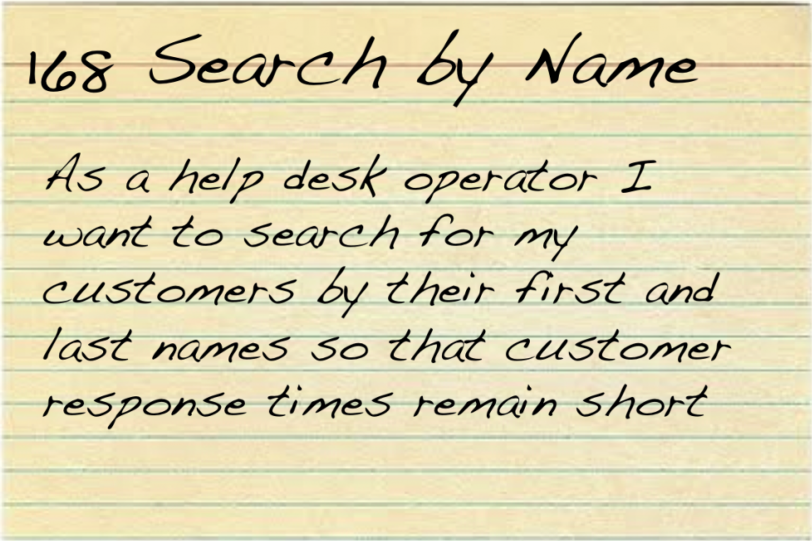
Problem analysis
aka story slicing
Solution design
aka data-flow design
Implementation aka coding

